Slide 1
CORNER SENTINEL
Advanced Warning System for Steep Corner Accident Prevention
S8 EC-B Project Batch 1 :
Sidharth P Pai (ASI20EC061)
Sreedeep K (ASI20EC065)
Sreeram K R (ASI20EC069)
Udith G Menon (ASI20EC072)
Guided by :
Dr. Bobby Mathews .C
Dean Ph.D Programmes, ASIET

Slide 2
PROBLEM STATEMENT
Accidents at steep corners in hilly areas are a significant problem, often leading to severe injuries or fatalities.
These accidents are caused by a combination of factors, including:
Excessive speed
Poor visibility
Improper Road Resign
Wrong Side Driving

Slide 3
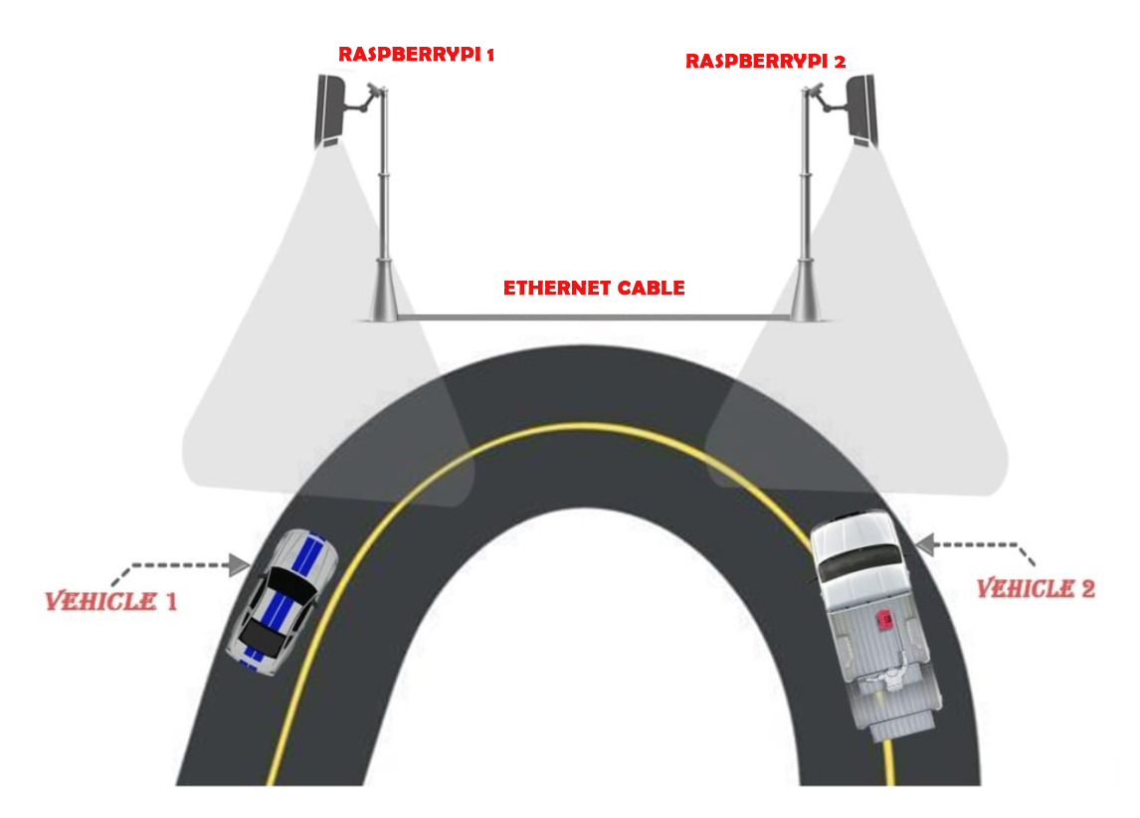
PROPOSED SYSTEM
We will collect our inferences on each corner with a Raspberry Pi-5 SBC.
The Raspberry Pi-5 SBC will run inferences using YOLO[1] on the live feed from its cameras.
Inferences of SBC will be exchanged with another SBC in real time via Ethernet cable.
After comparing inferences, the advanced warning signal will be sent via
Light Fidelity (Li-Fi).

Slide 4
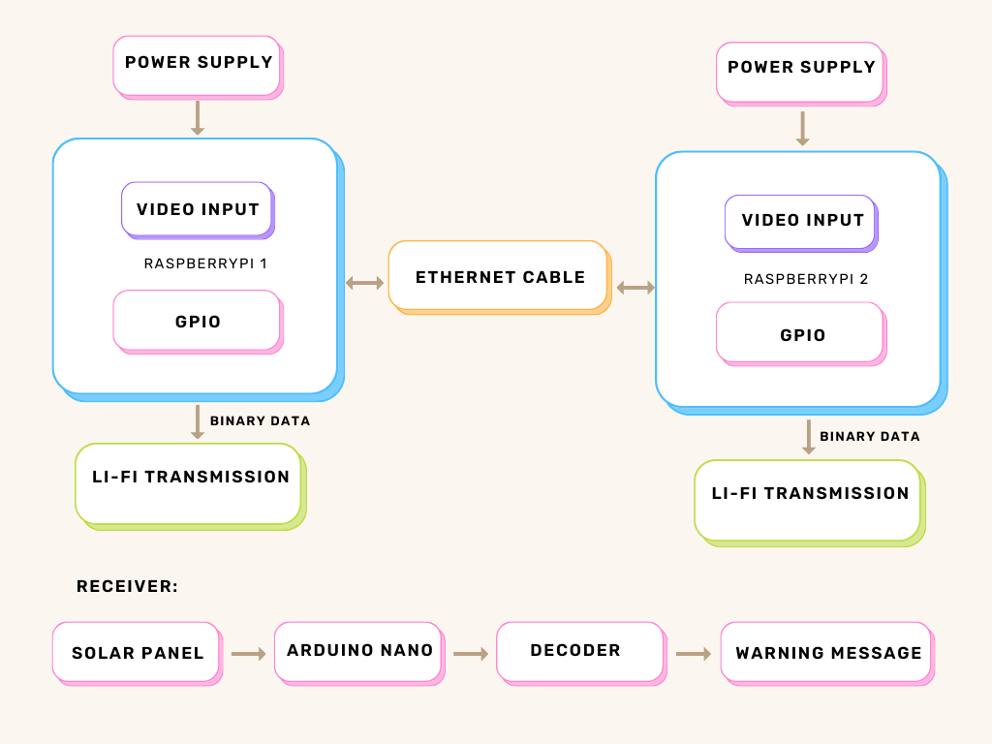
SYSTEM BLOCK DIAGRAM

Slide 5
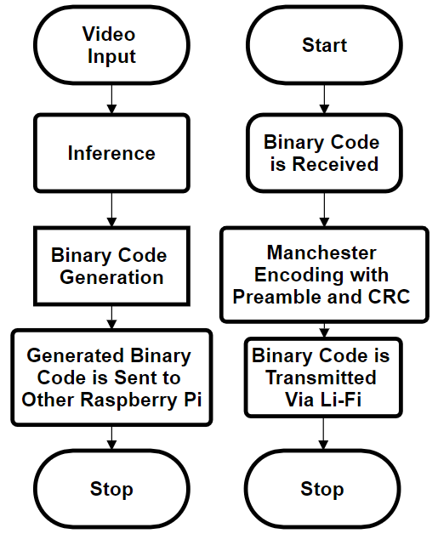
WORKING
1) Video Acquisition and Preprocessing:
Cameras capture live traffic feeds.
Preprocessing includes resizing and normalization.
2) Vehicle Detection and Classification:
Custom Trained YOLOv8 model identifies vehicles with high accuracy.
Outputs bounding boxes and class labels.
3) Vehicle Tracking:
Byte Track algorithm assigns unique IDs.
Tracks vehicles across frames.
4) Hazard Assessment and Binary Code Generation:
Corner Sentinel assesses risks based on the following Criteria
Speed
Wrong – Side Driving
Emergency Vehicle
Accident/Crash
Stationary Vehicle
Class of Vehicle
Generates binary code based on risk level.
5) Li-Fi Transmission:
Binary code transmitted via modulated LEDs using Manchester Encoding.
Custom timing libraries ensures reliable data transfer.
6) Warning Reception and Interpretation:
Vehicles equipped with receivers demodulate signals.
Warnings alert drivers to potential hazards.

Slide 6
MODEL DETAILS
The model we used is a custom implementation on the nano version of the Ultralytics YOLOv8 series. [1]
It was trained on a combination of Google’s Open Images Dataset V7 and a Indian-Vehicles dataset sourced from Roboflow. [4]
The Dataset was made using the Opensource FiftyOne tool and contained around 50000 images.

Slide 7
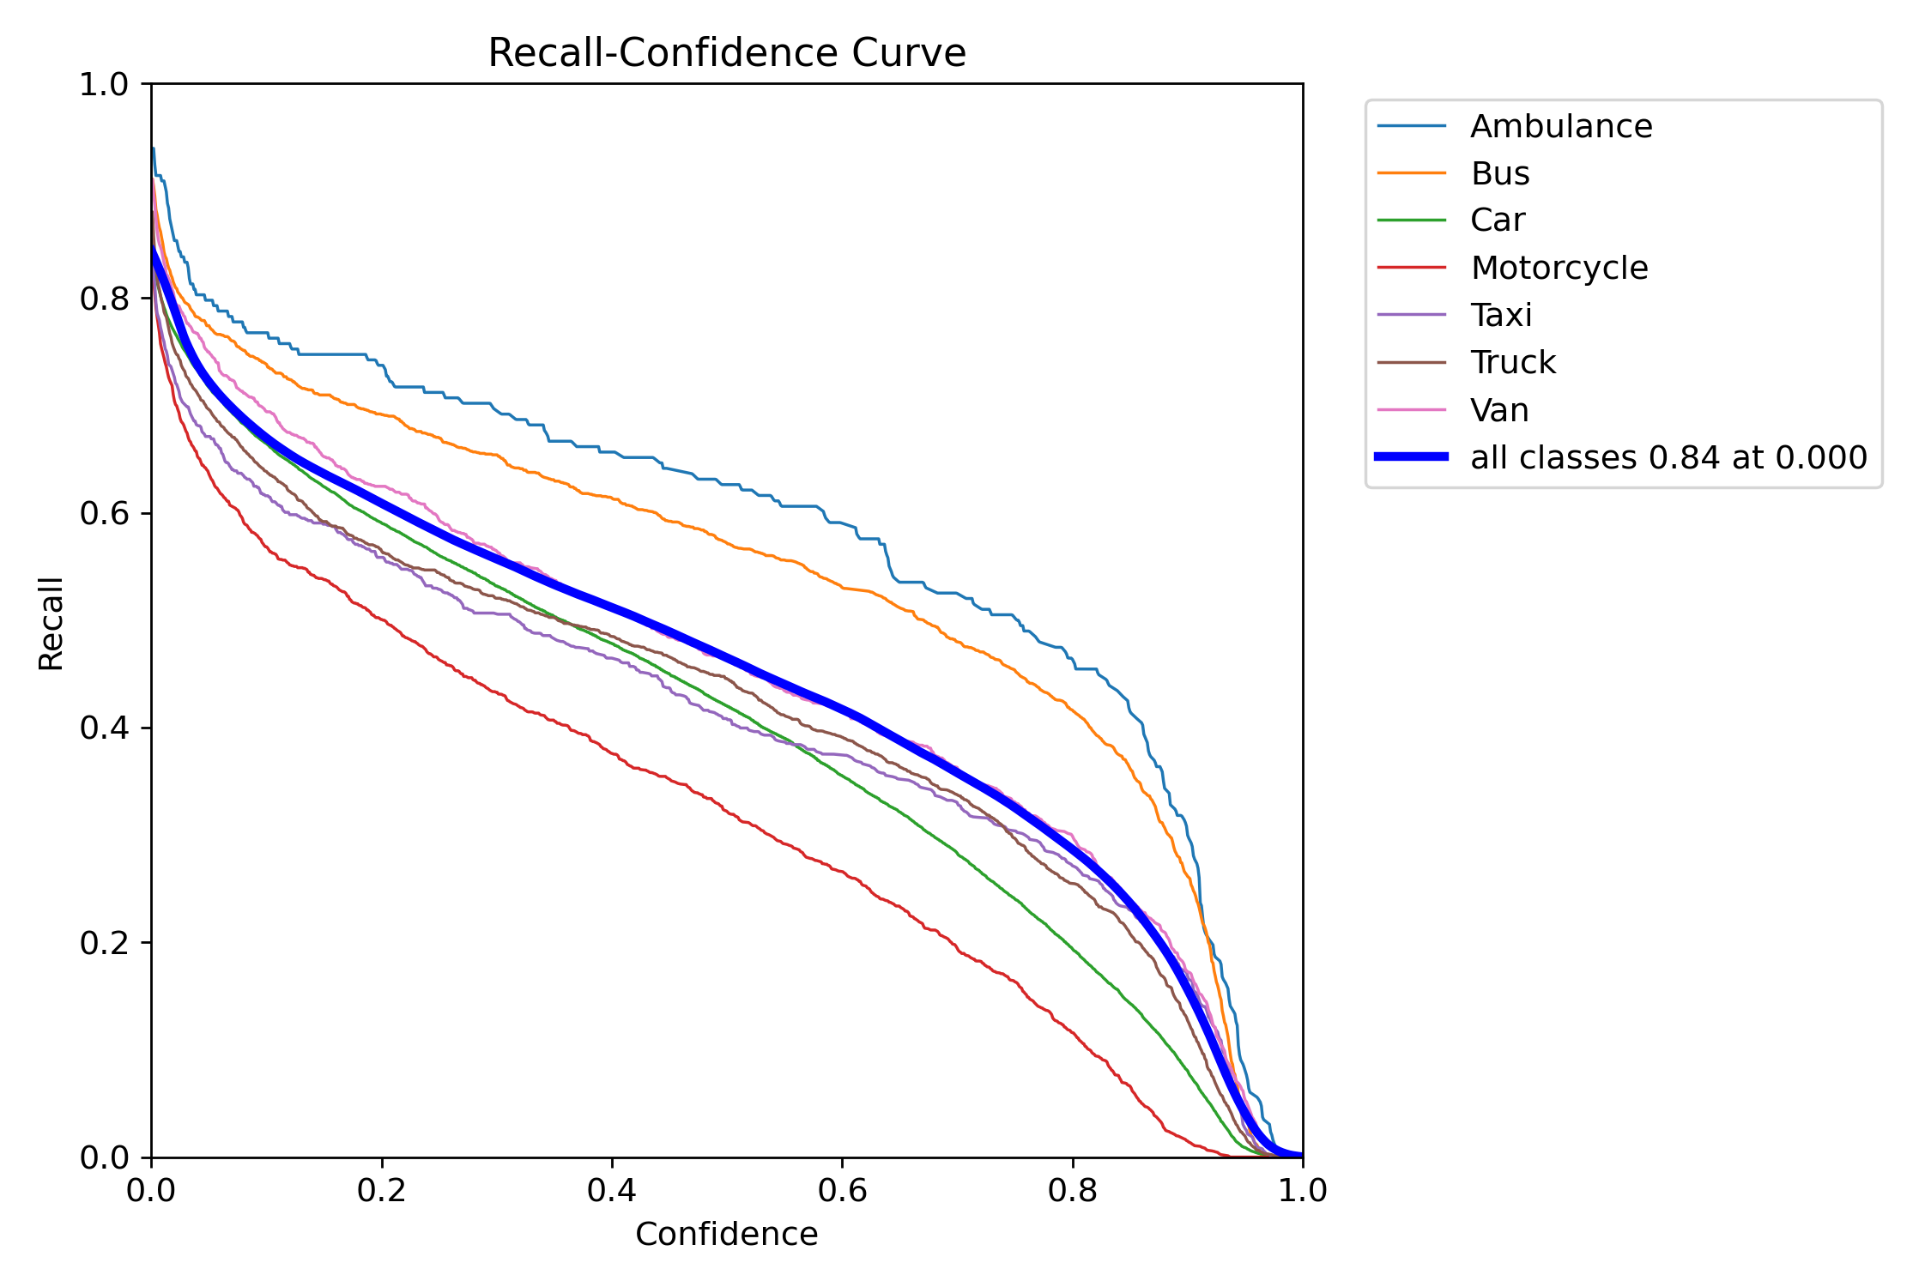
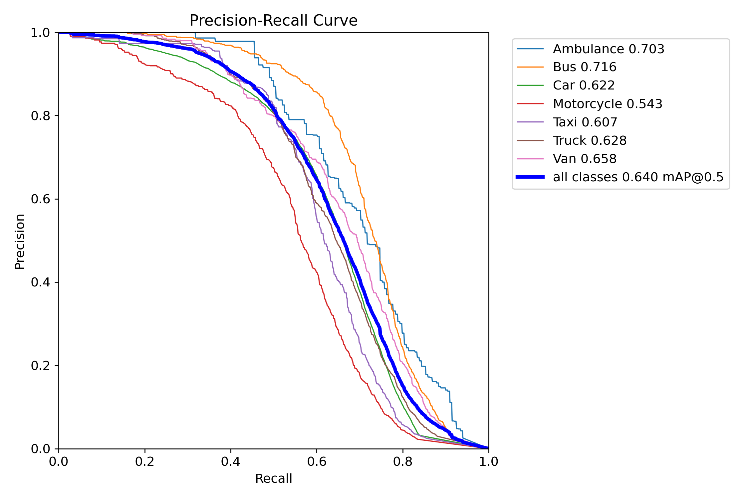
MODEL ACCURACY CHARTS

Slide 8
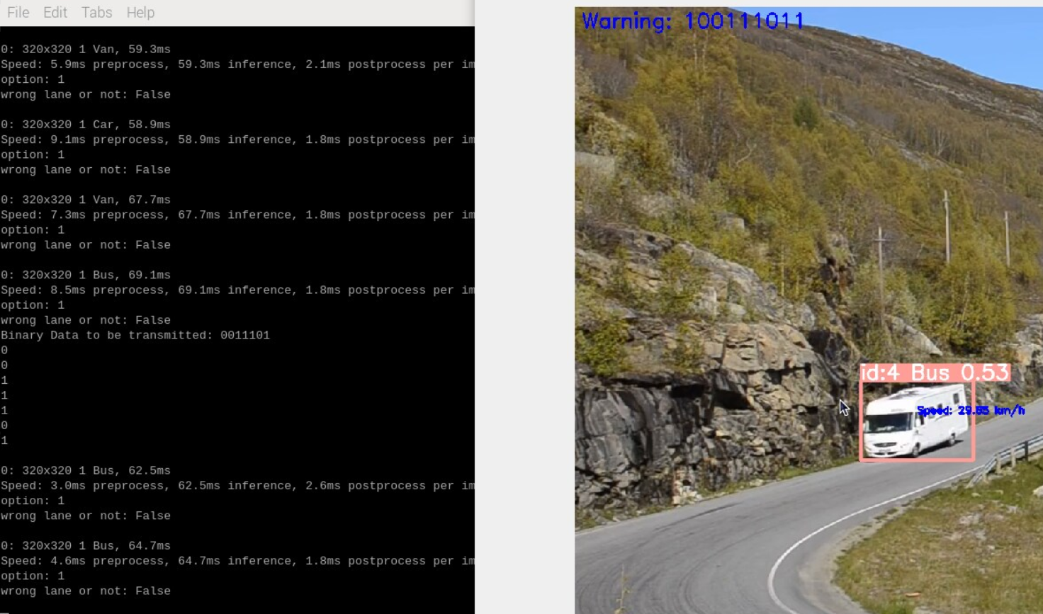
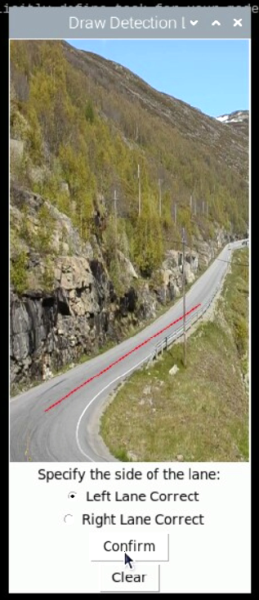
ML MODEL INFERENCE OUTPUT
WRONG LANE DETECTION

Slide 9
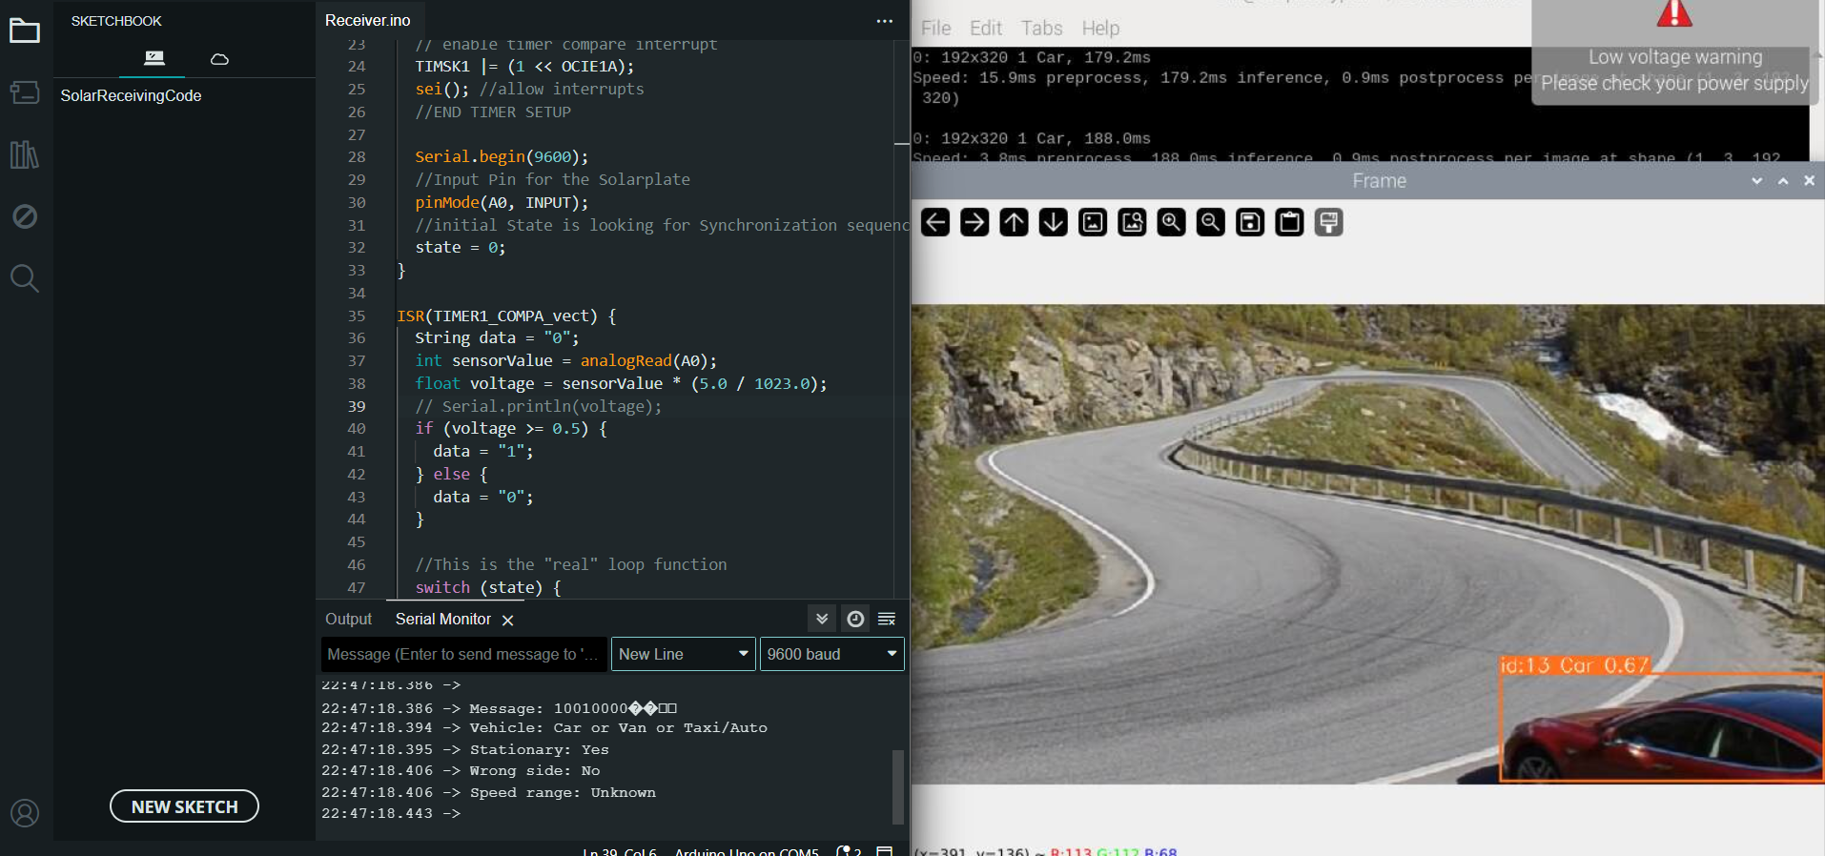
ML MODEL INFERENCE OUTPUT
STATIONARY VEHICLE DETECTION

Slide 10
HIGH PRECISION TIMER CODE
#include <sys/time.h>
int main()
{
struct timeval tval_before, tval_after, tval_result;
int counter=0;
bool stop=false;
gettimeofday(&tval_before, NULL);
while(stop!=true)
{
gettimeofday(&tval_after, NULL);
timersub(&tval_after, &tval_before, &tval_result);
double time_elapsed = (double)tval_result.tv_sec + ((double)tval_result.tv_usec/1000000.0f);
while(time_elapsed < (TARGET_BIT_PERIOD_MS/1000)) // 1ms; you can change your desired time interval here
{
gettimeofday(&tval_after, NULL);
timersub(&tval_after, &tval_before, &tval_result);
time_elapsed = (double)tval_result.tv_sec + ((double)tval_result.tv_usec/1000000.0f);
}
gettimeofday(&tval_before, NULL);
if (counter==10000)
{
stop=true;
}
else
{
counter++;
}
}
return 0;

Slide 11
TIMER SETUP FOR ARDUINO
void setup()
{
cli(); //stop interrupts
// set timer interupt for 1khz increments
TCCR1A = 0; // set entire TCCR1A register to 0
TCCR1B = 0; // same for TCCR1B
TCNT1 = 0; //initialize counter value to 0;
// set timer count for 1khz increments
OCR1A = 2001; // = (16*10^6) / (1000*8) + 1 OCR1A = 2001 for 1kHz; // turn on CTC mode
TCCR1B |= (1 << WGM12);
// Set CS11 bit for 8 prescaler
TCCR1B |= (1 << CS11);
// enable timer compare interrupt
TIMSK1 |= (1 << OCIE1A);
sei(); //allow interrupts
//END TIMER SETUP
Serial.begin(9600);
pinMode(A0,INPUT); //Input Pin for the Solarplate
//initial State is looking for Synchronization sequence
state = 0;
}

Slide 12
STRUCTURE OF THE DATA PACKET
5 - Bit Preamble | 8 – Bit Data | CRC
10101 | 10010101 | 110
Synchronization | Binary Data | Error Correcting Code

Slide 13
DATA BITS ALLOCATION
1 | 0 | 0 | 1 | 0 | 1 | 0 | 1
STATIONERY OR NOT
ACCIDENT
VEHICLE TYPE
PROPER LANE OR NOT
SPEED

Slide 14
BINARY CODE BITWISE MAP
Bit | 7 | 6 | 5 | 4 | 3 | 2 | 1 | 0 | Specification
Val | St | A | C2 | C1 | C0 | W | S1 | S0
St | 0 |  |  |  |  |  |  |  | No Stationary Vehicle
St | 1 |  |  |  |  |  |  |  | Stationary Vehicle Detected
A |  | 0 |  |  |  |  |  |  | No Accident/Crash
A |  | 1 |  |  |  |  |  |  | Accident/Crash Detected
C |  |  | 1 | 0 | 0 |  |  |  | Ambulance
C |  |  | 0 | 1 | 0 |  |  |  | Car
C |  |  | 0 | 0 | 1 |  |  |  | Bike
C |  |  | 0 | 1 | 1 |  |  |  | Truck/Bus (HMV)
W |  |  |  |  |  | 0 |  |  | Not Wrong Lane
W |  |  |  |  |  | 1 |  |  | Wrong Lane
S |  |  |  |  |  |  | 0 | 1 | 1.5kmph < Speed < 40kmph
S |  |  |  |  |  |  | 1 | 0 | 40kmph<Speed<60kmph
S |  |  |  |  |  |  | 1 | 1 | Speed > 60kmph

Slide 15
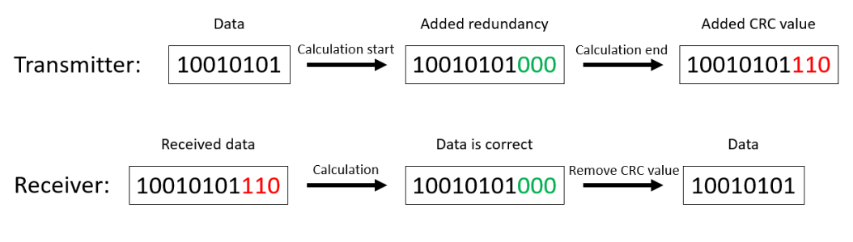
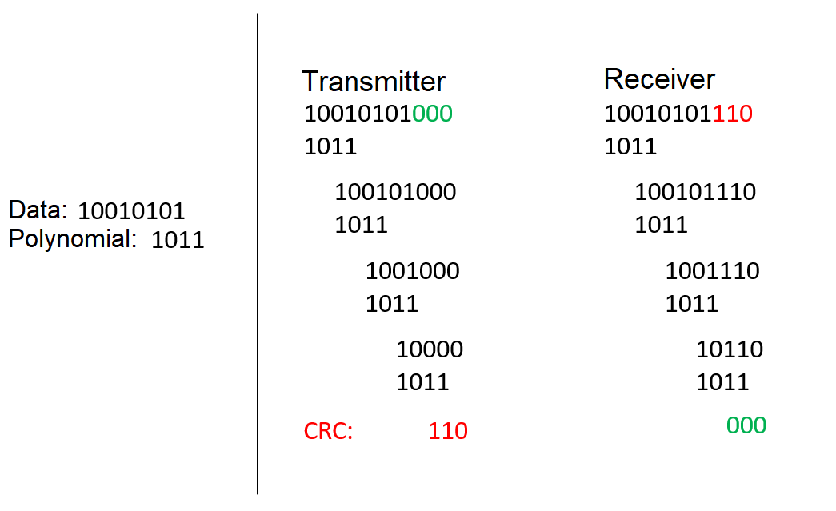
CRC CHECKING
CRC Calculation:
Choose a generator polynomial.
Append zeros to data packet.
Perform polynomial division for CRC value.
Error Checking:
Append CRC value to transmitted packet.
Receiver repeats polynomial division.
Zero remainder indicates correct transmission.

Slide 16
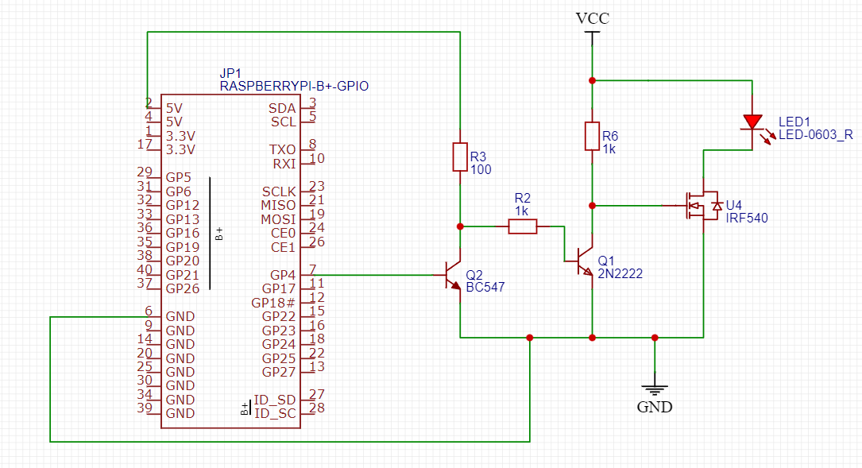
Li-Fi TRANSMITTER CIRCUIT [7]

Slide 17
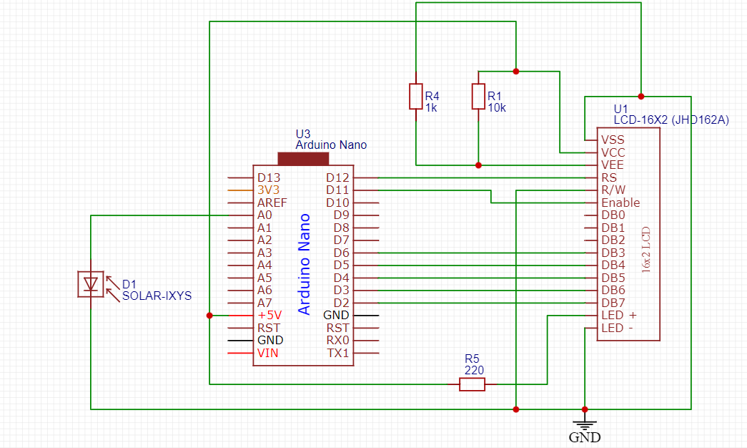
Li-Fi RECEIVER CIRCUIT [2,6]

Slide 18
WORK COMPLETED IN PHASE 1
Created and Implemented a Machine Learning model for Vehicle detection, Tracking, Speed detection and Vehicle categorization and to check if it is stationary or not.
Generated a binary sequence corresponding to the potential risks.
Made a Li-Fi transceiver prototype that transmits a binary message signal and decodes it into corresponding readable messages.

Slide 19
WORK COMPLETED IN PHASE 2
Implemented Wrong-lane and accident/crash detection. [3,5]
Integrated ML model output to Li-Fi transmission code
Established Full-Duplex Connection between the two Raspberry Pi’s for exchanging the binary codes.
Implemented Multi-Threading to facilitate Seamless LiFi transmission without stopping Inference.
Implemented custom timings functions/libraries for raspberry pi to get most accurate counters.
Implemented Preamble Synchronization and CRC error checking to LiFi Transmission.
Implemented Dynamic Threshold through which the receiver auto-adjusts the OOK threshold according to ambient lighting.
Implemented Manchester Encoding to reduce extreme flickering of Light.

Slide 20
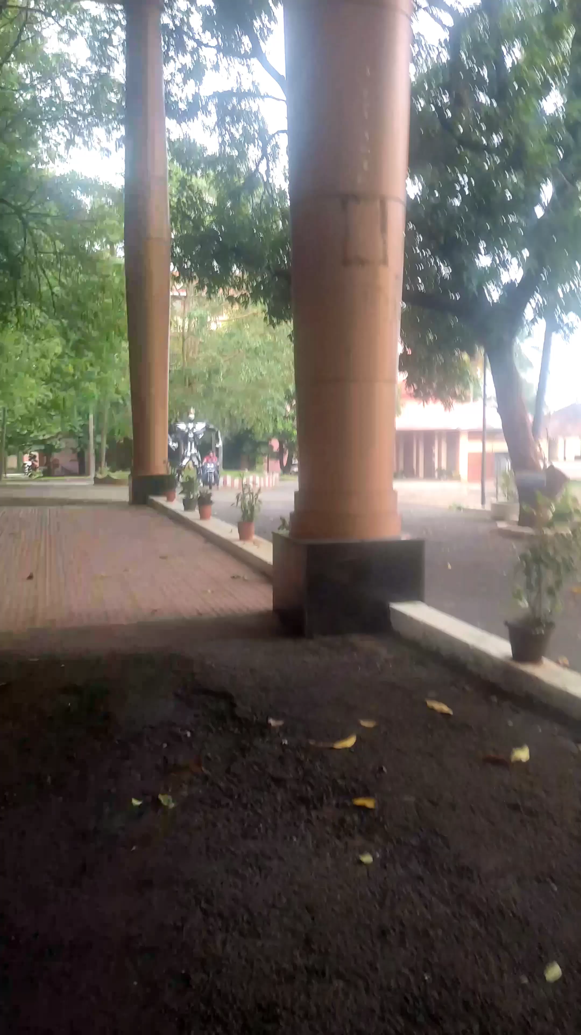
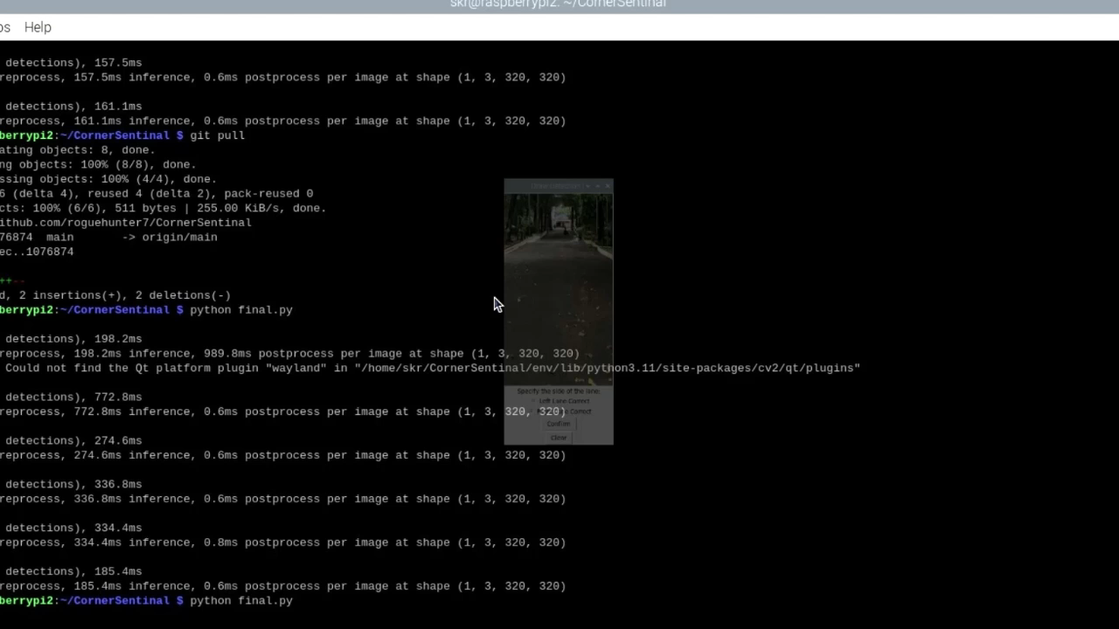
REAL TIME WORKING RESULT

Slide 21
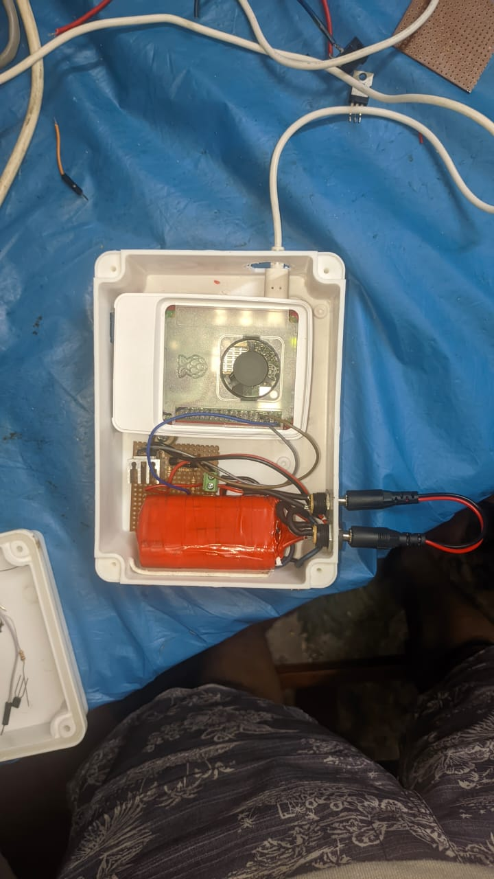
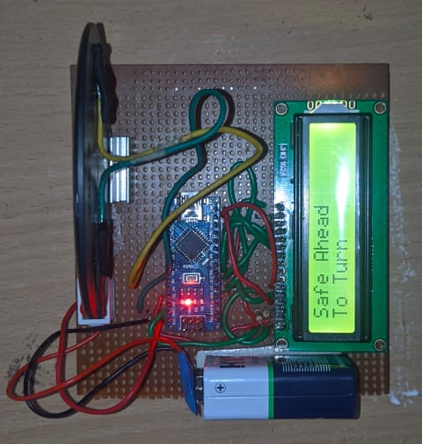
REALISED CIRCUITS
TRANSMITTER
RECEIVER

Slide 22
CONCLUSION AND FUTURE WORK
Corner Sentinel embodies a significant advancement in road safety technology, effectively harnessing the power of AI and Li-Fi communication to mitigate the risks associated with steep corners and limited visibility.
The system's ability to detect potential hazards, assess risk levels, and transmit timely warnings to approaching drivers has the potential to dramatically reduce accidents and save lives.
Future work can greatly optimise the system performance by:
The ML model’s performance can be improved by using newer and more optimised versions of YOLO.
The Li-Fi Circuitry can be improved by introducing proper filtering and noise reduction at the receiver side and using more optimised algorithms to encode the message.

Slide 23
REFERENCES
Z. Wang, J. Zhan, C. Duan, X. Guan, P. Lu, and K. Yang, “A Review of Vehicle Detection Techniques for Intelligent Vehicles,” IEEE Transactions on Neural Networks and Learning Systems, vol. 34, no. 8, pp. 3811–3831, Aug. 2023, doi: 10.1109/tnnls.2021.3128968.
P. Goswami and M. K. Shukla, “Design of a Li-Fi Transceiver,” Wireless Engineering and Technology, vol. 08, no. 04, pp. 71–86, 2017, doi: 10.4236/wet.2017.84006.
A. Gomaa, T. Minematsu, M. M. Abdelwahab, M. Abo-Zahhad, and R. Taniguchi, “Faster CNN- based vehicle detection and counting strategy for fixed camera scenes,” Multimedia Tools and Applications, vol. 81, no. 18, pp. 25443–25471, Mar. 2022, doi: 10.1007/s11042-022-12370-9.
M. Letavay, M. Bažant, and P. Tuček, “Object Detection Algorithms - A Review,” 2023 International Conference on Control, Artificial Intelligence, Robotics & Optimization (ICCAIRO), Apr. 2023, doi: 10.1109/iccairo58903.2023.00014.
S. Maity, A. Bhattacharyya, P. K. Singh, M. Kumar, and R. Sarkar, “Last Decade in Vehicle Detection and Classification: A Comprehensive Survey,” Archives of Computational Methods in Engineering, vol. 29, no. 7, pp. 5259–5296, Jun. 2022, doi:10.1007/s11831-022-09764-1.
Wang, Z., Tsonev, D., Videv, S., Haas, H., & Xu, Z. (2015, September). On the design of a solar-panel receiver for optical wireless communications with simultaneous energy harvesting. In 2015 IEEE International Conference on Communications (ICC) (pp. 3684-3689). IEEE.
Güray Yıldırım, Özgür Özen, Heba Yüksel, M Naci İnci, “A Low-Cost Li-Fi Communication Setup”, Bogazici University, Physics Department, Istanbul, Turkey.

Slide 24
THANK YOU

